Slide 1
Nonlinear Optimal Tracking Control of Wind Energy Conversion System in Partial Load Region
Sudipta Paul Graduate Teaching Assistant Department of Electrical Engineering University of Minnesota Duluth | D. Subbaram Naidu, Fellow IEEE Minnesota Power Jack F. Rowe Endowed Chair Professor, Department of Electrical Engineering University of Minnesota Duluth

Slide 2
Paper Goal and Contribution
Presents a complete sixth-order nonlinear model of a PMSG based variable speed variable pitch wind energy conversion system (VSVP-WECS).
Presents a State Dependent Differential Riccati Equation (SD-DRE) control technique for closed-loop, finite horizon (FH) tracking of nonlinear systems.
Validates the finite horizon SDRE tracking for PMSG based WECS in partial load region.

Slide 3
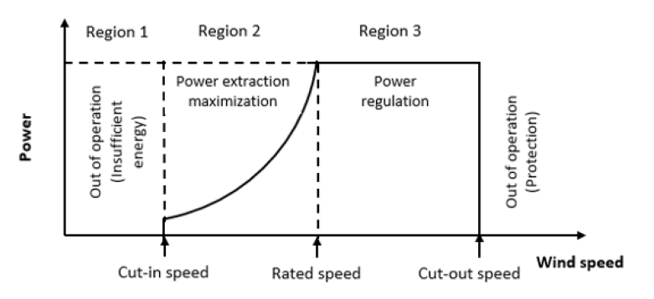
Wind Turbine Operating Regions
A wind turbine has three main operating regions.
Region 1: The wind speed is below the cut-in speed, and the power generation is halted.
Region 2: The turbine operates at partial load below the rated power.
Region 3: Power generation reaches its maximum value and stays there.
When the wind speed exceeds the cut-out speed, the turbine shuts off.

Slide 4
Partial Load Operation
Goal: Maximize the energy efficiency by keeping the power coefficient at its maximum value.
Pitch angle and the tip speed ratio (TSR) should operate at their optimal values
For optimal TSR, the wind rotor speed should be controlled in such a way that it tracks an optimal reference speed

Slide 5
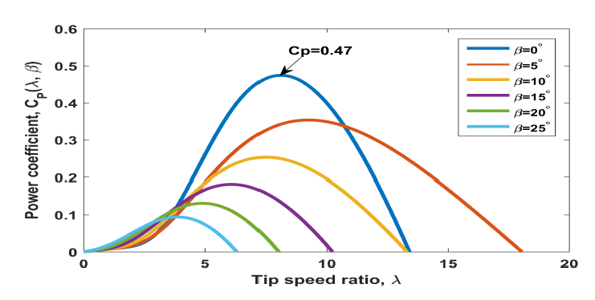
WECS Modeling
Maximum power coefficient : 0.47
Optimal TSR : 8.1
Optimal Pitch angle: 0 deg
Power coefficient as a function of tip speed ratio for different blade pitch angle

Slide 6
WECS Modeling
ω_{r} – wind rotor speed
ω_{g} – generator speed
T_{g} – Generator torque
T_{H} – Internal torque
i – Gearbox ratio
η – Gearbox efficiency
J_{r} – Wind rotor inertia
T_{r} – Aerodynamic torque
J_{g} – Generator inertia
K_{g} – High speed shaft stiffness coefficient
B_{g} – High speed shaft damping coefficient
β – Pitch angle of the blade
Β_{d} – Desired pitch angle
i_{d}, u_{d} – d axis current and voltage
i_{q}, u_{q}– q axis current and voltage
R_{s} – Resistance of the stator
L_{d}, Lq – d and q axis inductance
p – number of poles
Ф_{m} – PMSG flux linkage
R – wind rotor plane radius
C₀–C₇ – Polynomial coefficients

Slide 7
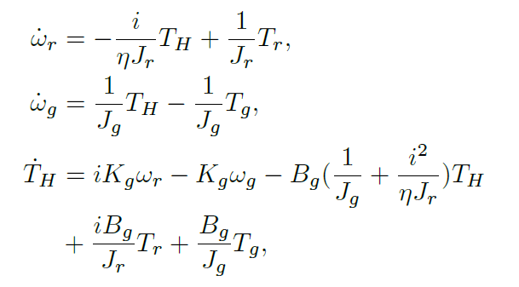

WECS Modeling
Flexible Drive train dynamic model
Pitch actuator dynamics

Slide 8
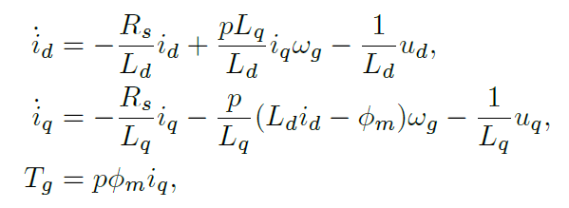
WECS Modeling
PMSG dynamic model in (d,q) axes

Slide 9
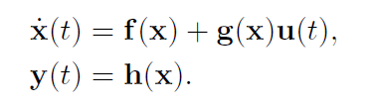

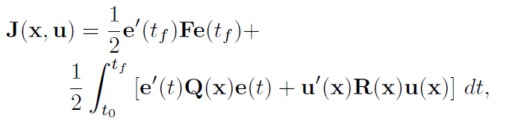
FH-SDRE Tracking Controller
Given a nonlinear system
State-Dependent Coefficient (SDC) Form
Finite horizon cost function

Slide 10

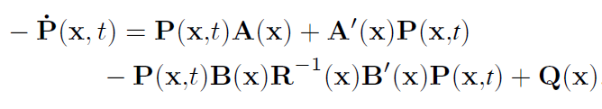

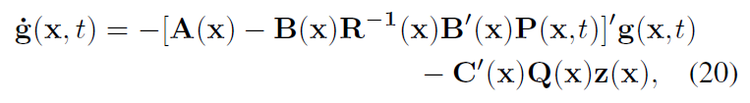


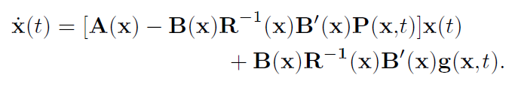
FH-SDRE Tracking Controller
State feedback control law
Differential Riccati Equation (DRE)
with final condition,
Vector differential equation (VDE)
with final condition,
SD-DRE controlled trajectory

Slide 11




FH-SDRE Tracking Controller
Algorithmic steps for solving P(x,t)
Step-1: Solve ARE to find P_{SS}(x)
Step-2: Use change of variable to get
Step-3: Calculate A_{cl}(x)
Step-4: Solve algebraic Lyapunov equation for D

Slide 12
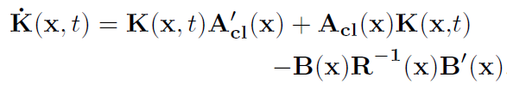

FH-SDRE Tracking Controller
Algorithmic steps for solving P(x,t)
Step-5: Solve DLE
The solution is found as
Step-6: Obtain P(x,t) as

Slide 13
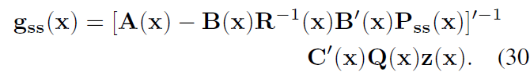

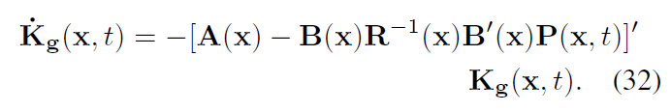
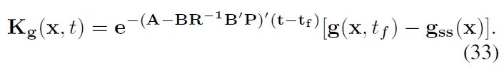
FH-SDRE Tracking Controller
Algorithmic steps for solving g(x,t)
Step-1: Solve VAE to find g_{SS}(x)
Step-2: Use change of variable to get
Step-3: Solve differential equation
The solution is found as

Slide 14

FH-SDRE Tracking Controller
Step-4: Obtain g(x,t) as
State feedback optimal control law

Slide 15
FH-SDRE Tracking Controller
At t=t₀ , X = X₀
Solve VAE
The system A(x), B(x), C(x)
Solve ARE
g_{SS}(x)
P_{SS}(x)
Apply change of variable
Apply change of variable
Solve VDE
g(x,t)
Solve DRE
P(x,t)
K_{g}(x,t)
t = t + ∆t
K(x,t)
Solve ALE
Solve DE
A_{cl} , D
Solve K_{g}(x,t)
Find optimal control, u(x,t)
Solve DLE
Find g(x,t)
Solve K(x,t)
t<t_{f}
Find P(x,t)
Stop

Slide 16
Simulations & Results
The nonlinear model of PMSG-WECS
The nonlinear system of the form

Slide 17




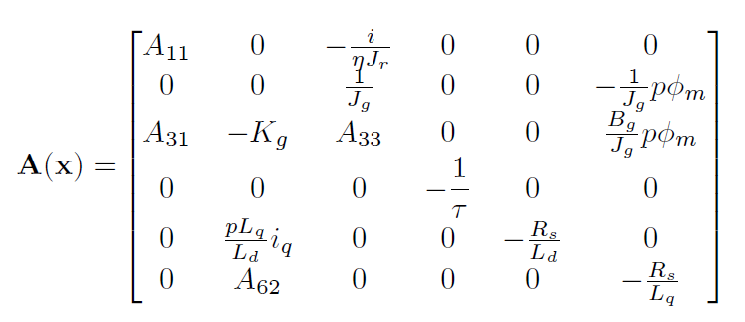
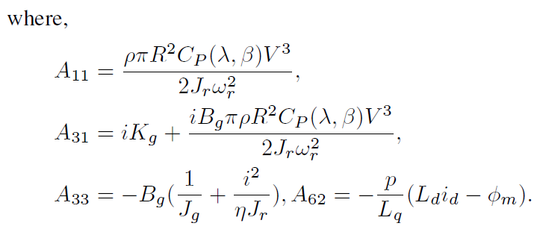
Simulations & Results
SDC representation
State vector of VSVP-WECS
And, control vector

Slide 18
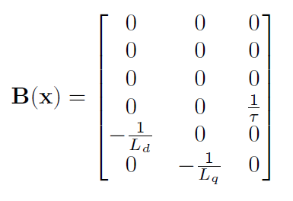


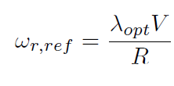
Simulations & Results
For a given wind speed V, and blade radius R, the reference rotor speed for tracking performance is found as

Slide 19
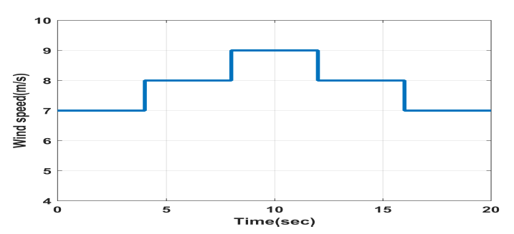
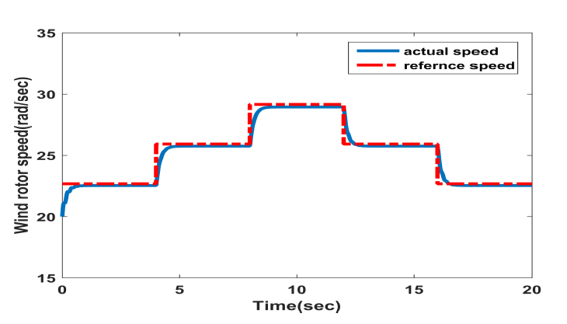
Simulations & Results
Reference wind speed
Wind turbine rotor speed tracking via finite horizon SDRE

Slide 20
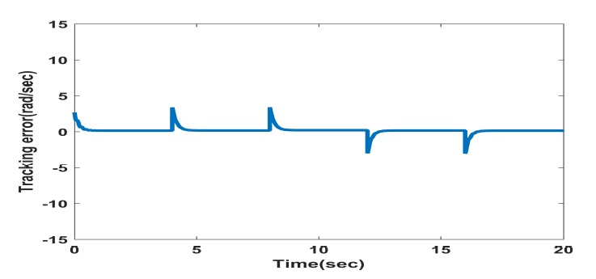
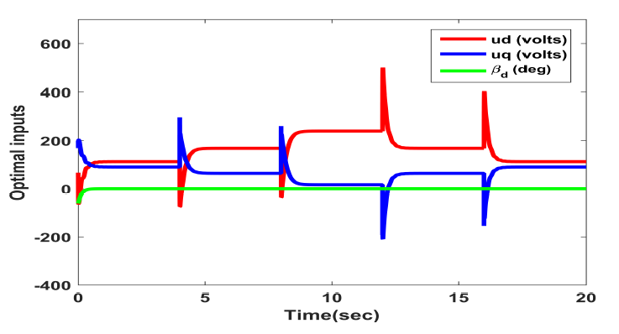
Simulations & Results
Wind turbine rotor speed tracking error
Nonlinear optimal controller via FH SDRE

Slide 21
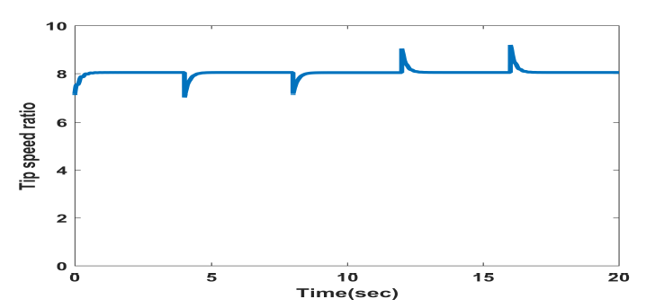
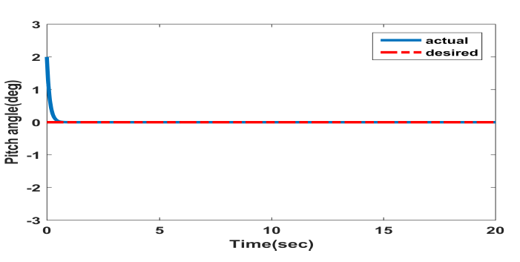
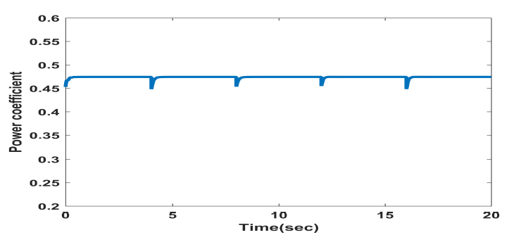
Simulations & Results
Tip speed ratio throughout the partial load region
Pitch angle throughout the partial load region
Power coefficient throughout the partial load region

Slide 22
Conclusion
FH optimal tracking controller via SDRE technique is presented for a variable speed WECS with PMSG at partial load region.
The main purpose of the control strategy is to track the reference rotor speed and maintain the maximum power coefficient throughout the Region 2.
Optimal control for tracking reference rotor speed is found in terms of the solution of SD-DRE and SD-VDE.
Simulation results validates the effectiveness of the FH SDRE tracking controller for PMSG based WECS.

